Slide 1
Learn How to Simplify
Multi-Channel Live Streaming with the MediaDS
Jamie Sherry, Will Waters & Ryan Jespersen
August 2, 2017

Slide 2





Jamie Sherry
Will Waters
Ryan Jespersen
Senior Product Manager
Server Technologies
Director of Product Marketing, Sales Enablement & Professional Workflow Team
Regional Manager
Europe, Middle East and Africa

Slide 3
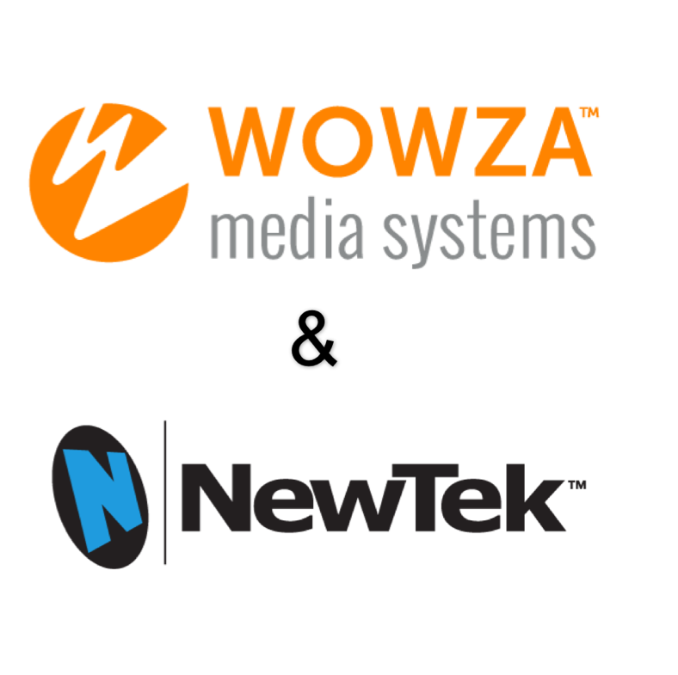
Agenda
NewTek and Wowza
Introducing the MediaDS
Segment Specific Workflows
  Enterprise
  Broadcasting
  Sports
Case Studies
  Commonwealth of Massachusetts
  Placentia – Yorba Linda School District
Demonstration
Q&A

Slide 4
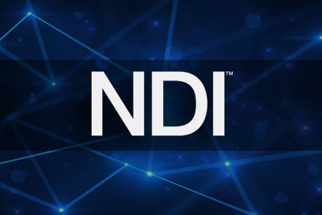
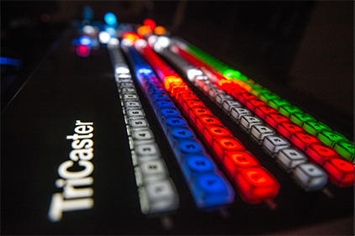
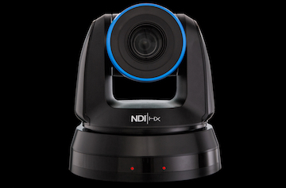
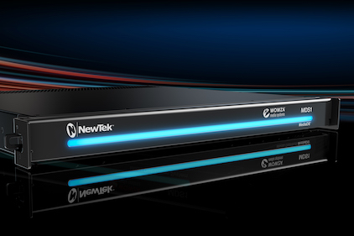

About NewTek
As the leader in IP video technology, NewTek is transforming the way people create network-style television content and share it with the world.
From sporting events, Web-based talk shows, live entertainment, classrooms, and corporate communications, to virtually any place people want to capture and publish live video, we give our customers the power to grow their audiences, brands and businesses faster than ever before.

Slide 5
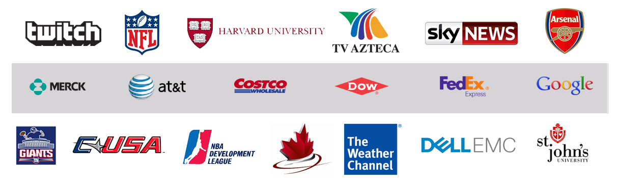
NewTek Clients Include:

Slide 6




Wowza: Powerful, Proven Streaming Software
WOWZA POWERS
END-TO-END VIDEO & AUDIO WORKFLOW
DEEP DEVELOPER INTEGRATION VIA API, IDE AND SDK
ENORMOUS GLOBAL CUSTOMER BASE
STRATEGIC TO ALL CLOUD PLATFORMS
OVER 25%
OF WORLDWIDE LIVE STREAMING
345,000
Hours of Live
Transcoding per Day
43 Million
Live Broadcasts per Year
450 Million
Live Viewing Hours per Month
19,000
Paid Customers

Slide 7






































Wowza Customers
20,000 customers in 170 countries from the world’s most sophisticated Media, Telco, and Tech companies to small business & developers
SERVICE PROVIDERS
ENTERPRISE & GOVERNMENT
SPORTS
EDUCATION
EVERYONE
Video comprised 64% of global internet traffic in 2014 and will reach 80% by 2019
94% of young executives say video breaks down language barriers in the global market
Viewers of sports on mobile devices` doubled from 2011 to 2015
66% of university respondents said streaming is a top strategic initiative
19,000 customers across all industries build on Wowza for video & audio
~40% OF CDNS
WORLDWIDE RUN
WOWZA
70+ PERCENT OF GARTNER’S ENTERPRISE VIDEO QUADRANT
RUNS WOWZA
EVERY MINOR LEAGUE BASEBALL GAME RUNS
ON WOWZA
85% OF THE TOP 25 U.S. UNIVERSITIES, WITH 100% OF IVY LEAGUE RUN WOWZA
Houses of Worship
Transportation
Public Safety
Public Transit
Medical
Security
Armed Services

Slide 8
What is the MediaDS?
Hardware, Workflows, Use Cases

Slide 9
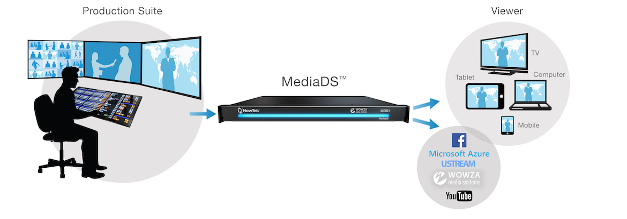
Bridging Content Creation to Delivery
The MediaDS™ is a revolutionary real-time media encoding and live streaming platform merging NewTek’s industry-leading live production technology with powerful Wowza™ streaming software, that delivers video directly to viewers – with or without the Internet.

Slide 10
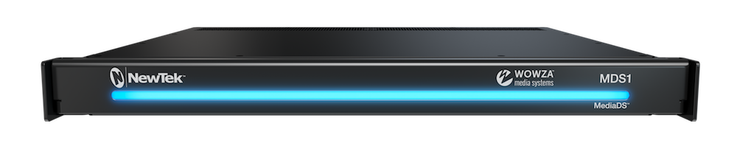
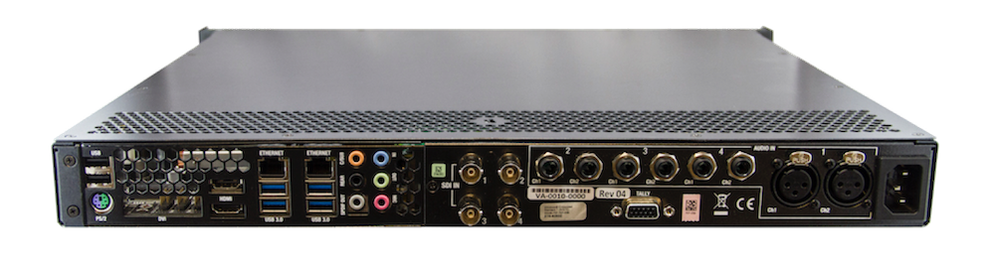
Introducing the MediaDS
Video delivery directly to viewers on a local network inside the firewall,
via an Internet CDN, or via a streaming service
Encoding of multiple content streams
Multi-platform delivery
Origin-edge streaming

Slide 11

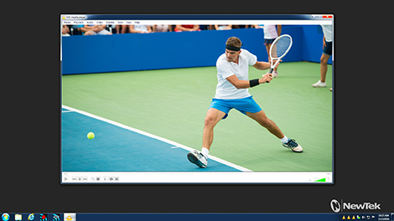
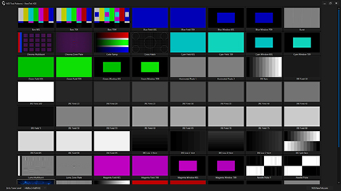
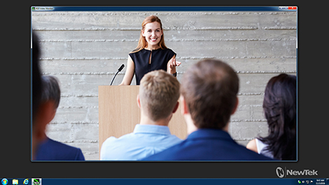
Benefits of the MediaDS
Seamless Integration
  3G/HD/SD-SDI and NDI connectivity
Flexible Delivery
  Deliver to Wowza Streaming Engine, Wowza Streaming Cloud and Wowza CDN
  Stream to Facebook Live, Microsoft Azure, Ustream, YouTube Live and more
Hosted Web Pages & Players
  Embedded Wowza Player for multi-device playback
Operator Workflow
  Dedicated multiviewer with independent color correction tools
  Integrated waveform, vectorscope and multi-channel audio level control
www.newtek.com/ndi/tools/
Notes:
Combining effortless enterprise deployment with a comprehensive, standalone transmission workflow spanning from signal origination at the SDI connection to content delivery over IP, theMediaDS enables your productions, presentations, and live events to be seen by anyone, anywhere, on any device—directly from your control room, studio or production site.

Slide 12
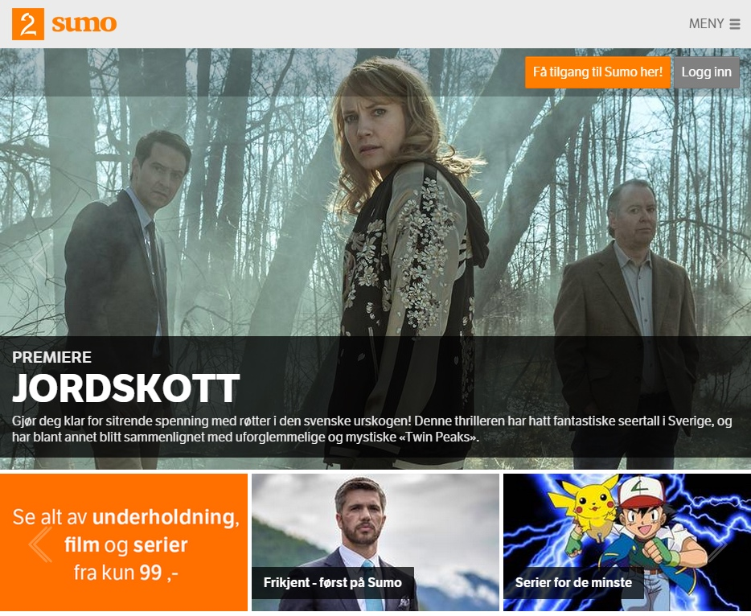
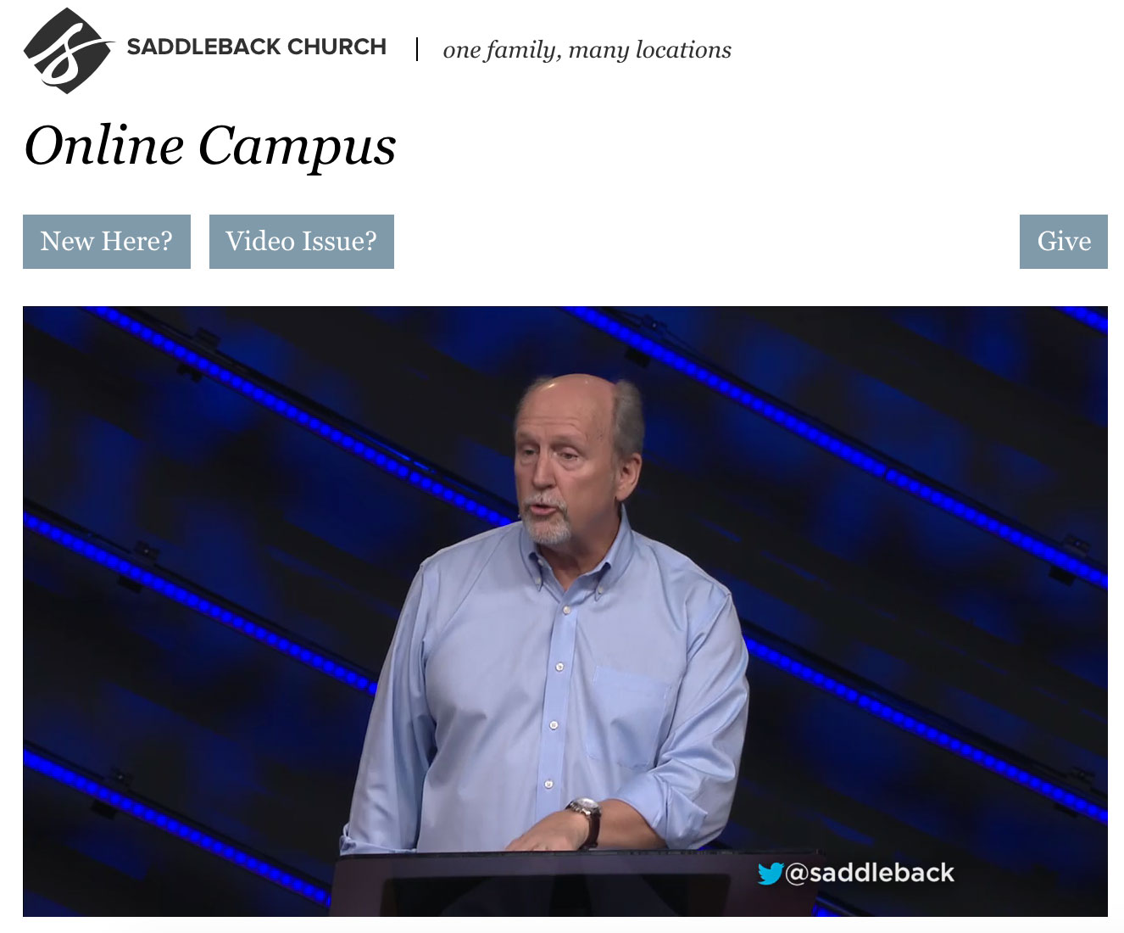
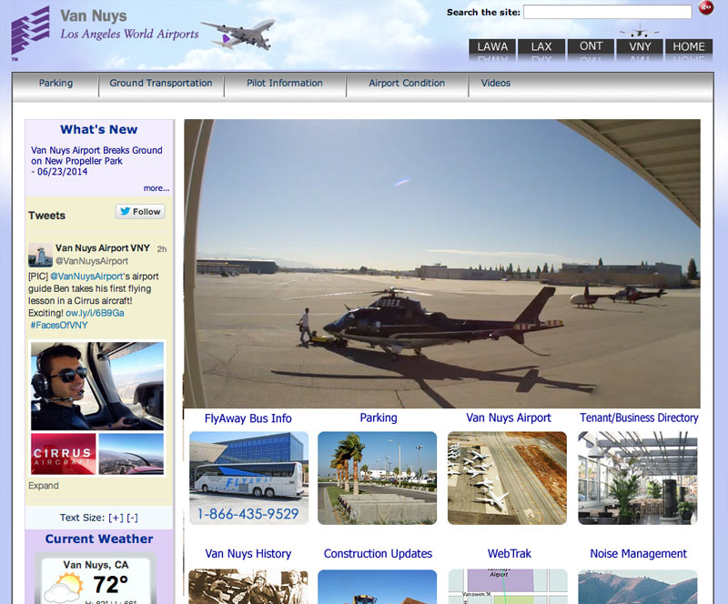
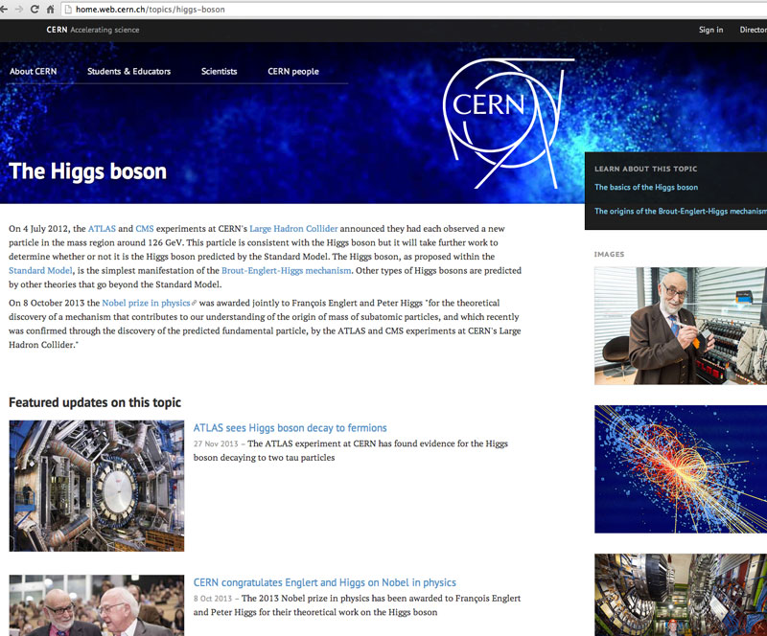
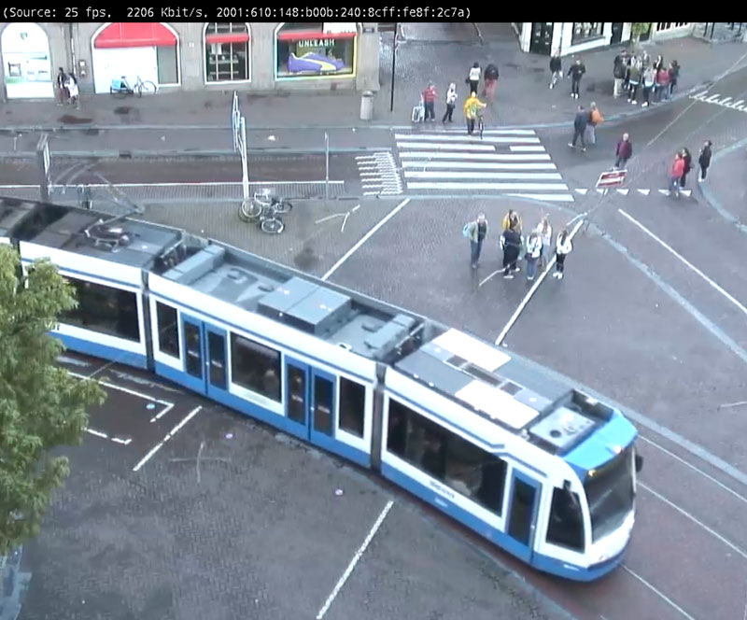
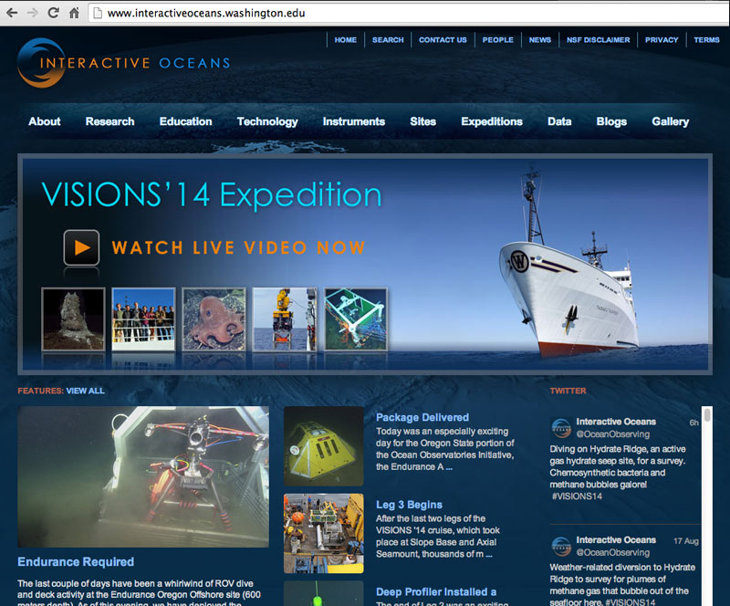
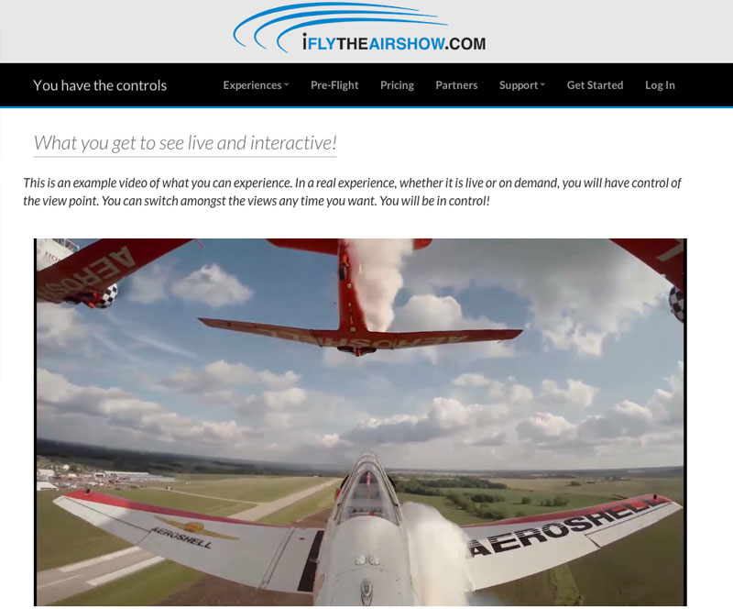
Industries
Broadcasting
(IPTV, OTT, TV Everywhere)
House of Worship
(Churches, Synagogues, Mosques)
Mobile Entertainment
(Planes, Trains, Buses, Cruise Ships)
Enterprise
(Corporations, Multi-nationals)
Government
(Town Halls, State, Federal)
Education
(Distance Learning, Universities)
Sports & Entertainment
(Concerts, Live Events)

Slide 13






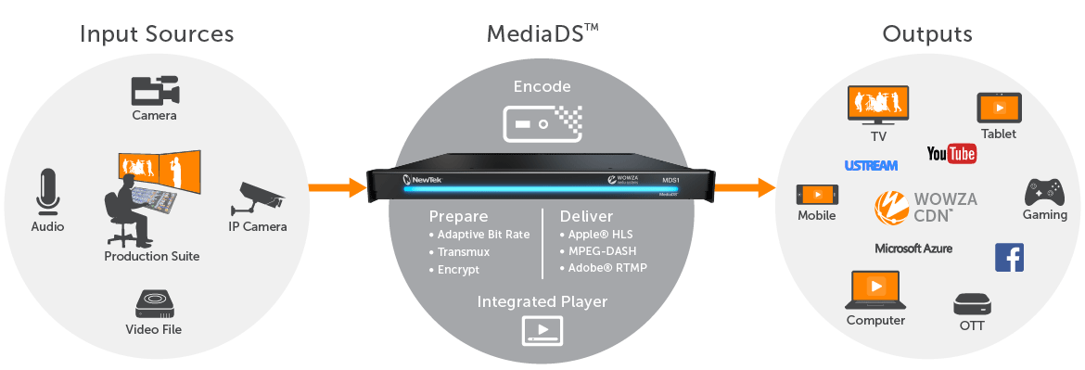
A Workflow for Every Industry

Slide 14

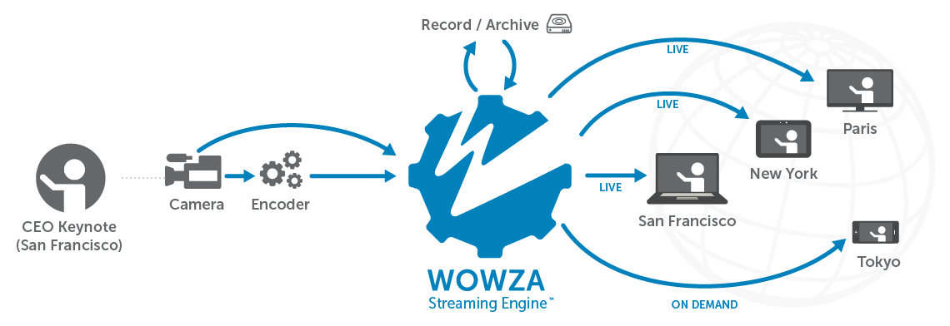
Enterprise Workflow

Slide 15
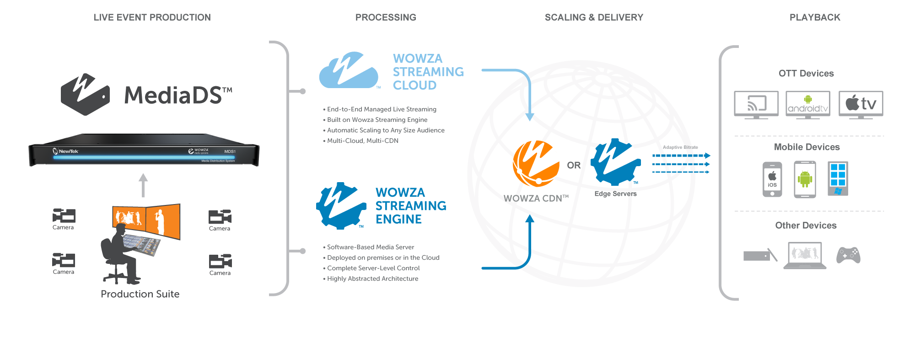
Broadcasting & OTT Workflow

Slide 16
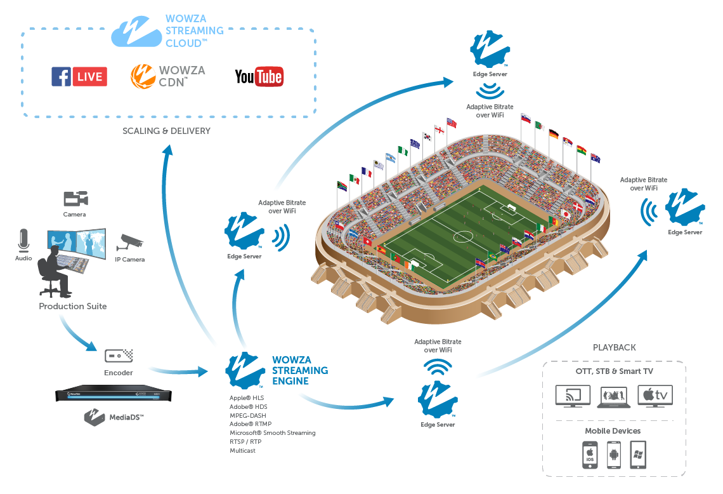
In-Venue & Stadium Workflow

Slide 17
Case Study
Real Life Applications, the Benefits and Vertical Use Cases

Slide 18


Case Study: Placentia – Yorba Linda School District
Current Phase
Production Suite
Concert or Event
Behind the Firewall
Internal Webpage
SDI
Sports Broadcasting
Future Phase
Lecture Capture
Stream Capacity: 2 live channels
Delivery Capacity: Local and Worldwide
Features: Live Transcoding, Live Stream Record, DVR, Analytics, Dedicated Web page per school
Location Cameras

Slide 19
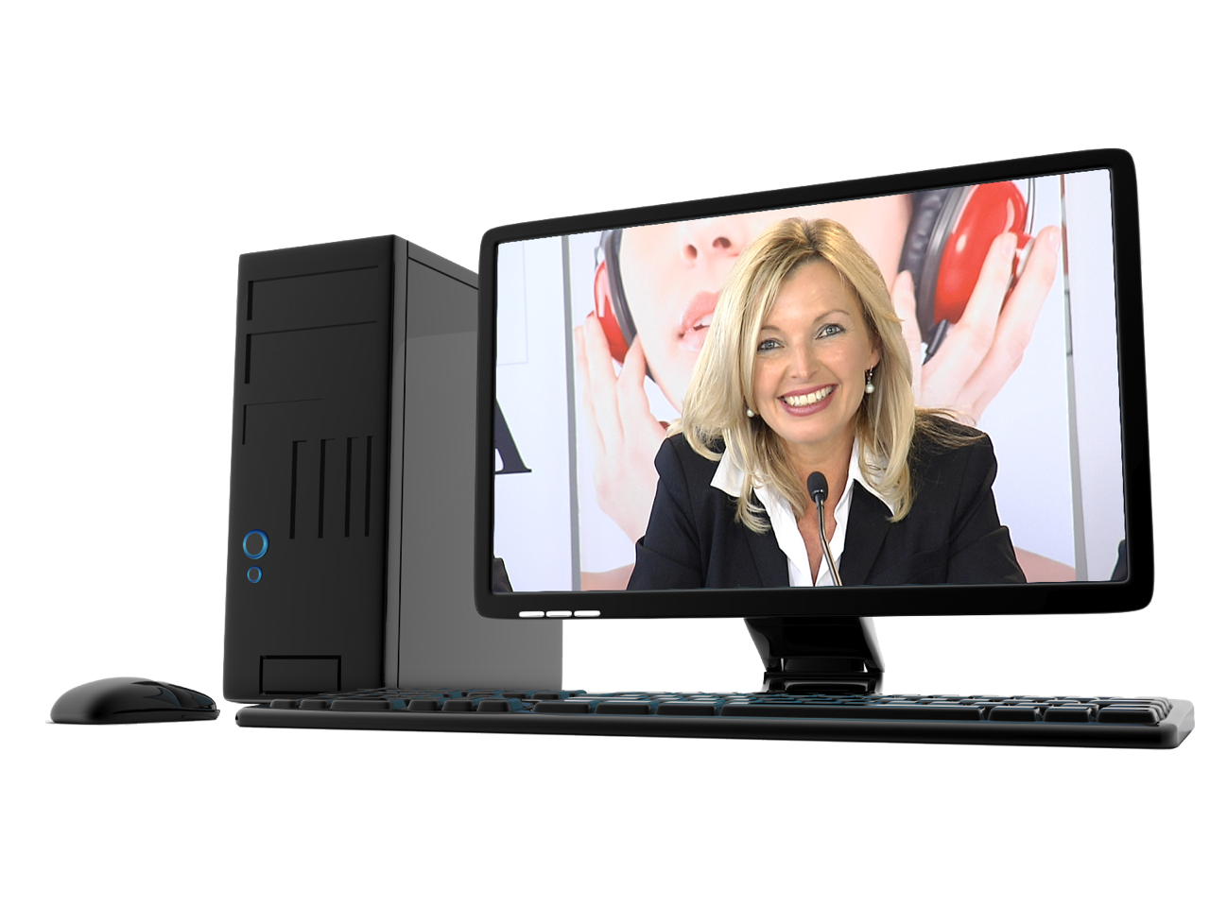
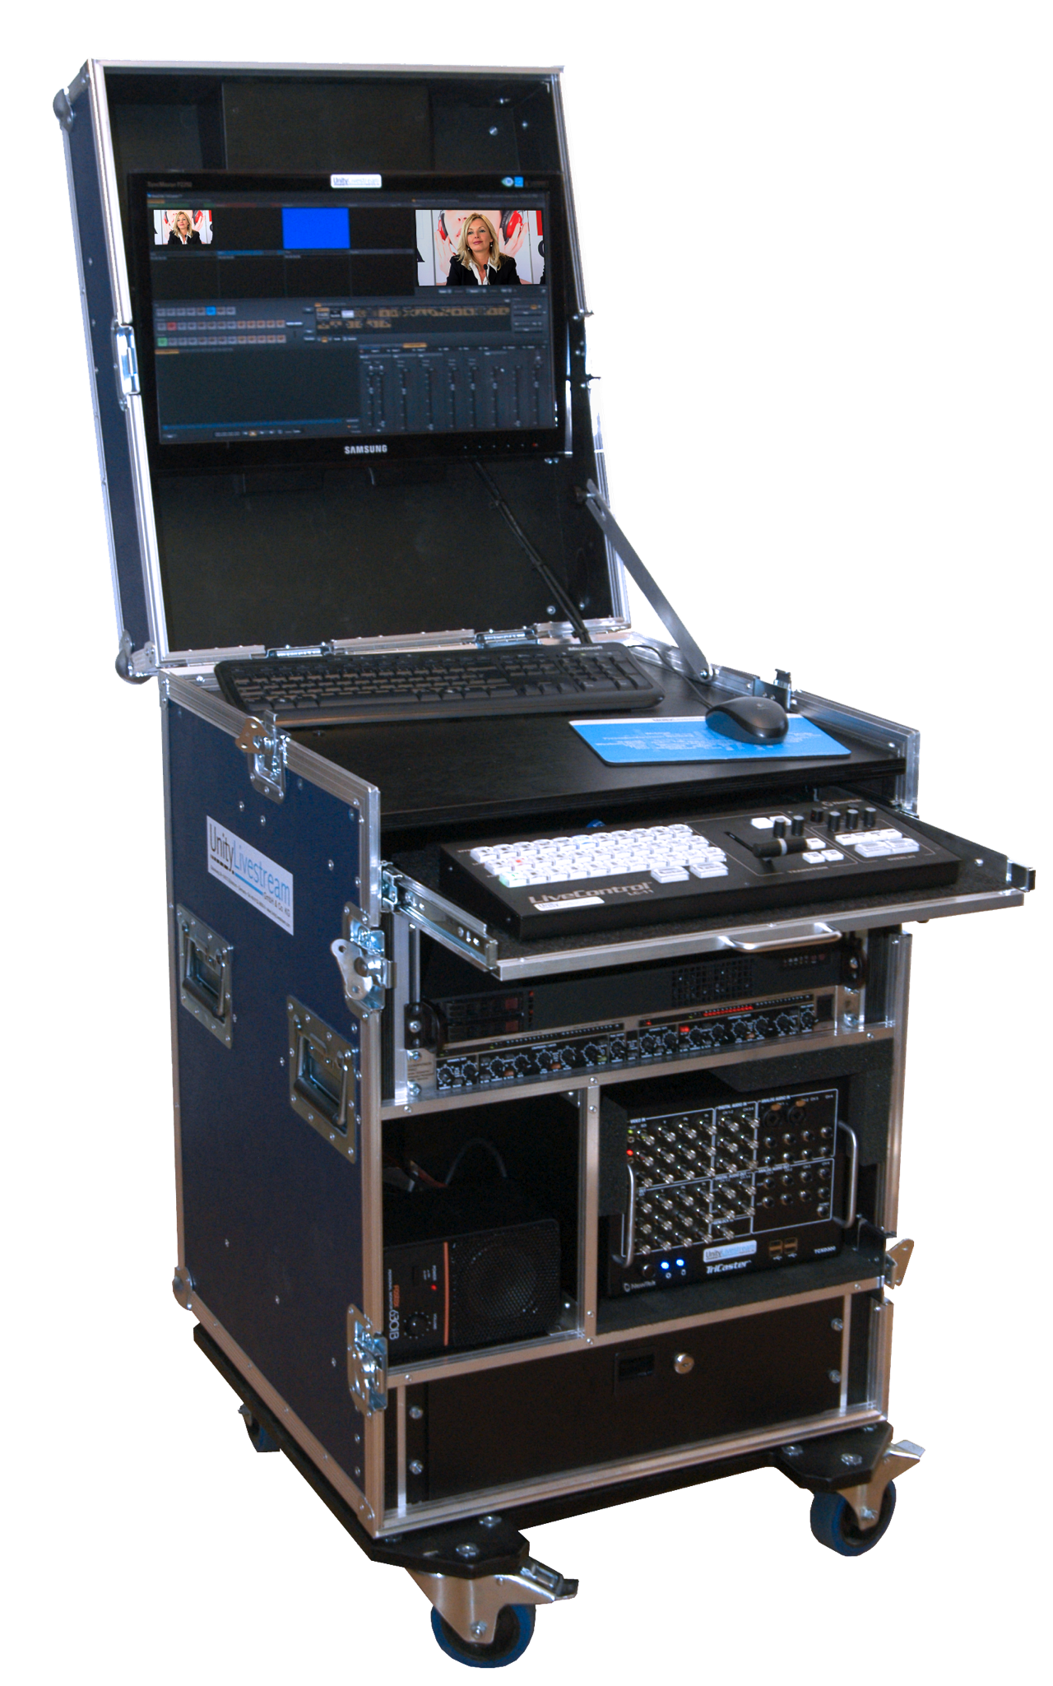

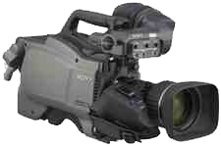
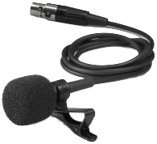





Case Study: Commonwealth of Massachusetts
Conference Room
Data center / Internal CDN
Internal clients
Encoder
Origin Server
Edge Servers
Computer
HD-SDI
Multicast
Signal
1080p
DVI or
VGA
HD-SDI
distributor
WOWZ Streams
WOWZ
Unicast
Signal
Apple HLS
& RTMP
1080p
LAN
ABR
Streams
HDMI or
HD-SDI
HD-SDI
iPad User
HD camera
& XLR audio
Video Capture
& Mixer
Backup
Encoder
Live ABR
Transcoding
LAN
Stream Target
HLS
Internet
External Clients
Stream Capacity: 4 Live ABR Channels
Delivery Capacity: 1,000+ users in-network
Features: Live Transcoding, Live Stream Record, DVR
Delivery Capacity: Local and Worldwide
Unicast Signal
Apple HLS & RTMP
Internet
Pay-as-you-go CDN
Mobile Users
Notes:
Technical articles we referenced during our call:
Wowza Origin/Edge environment: https://www.wowza.com/forums/content.php?227
Dynamic Load Balancing: https://www.wowza.com/forums/content.php?108
Load Test Tool: https://www.wowza.com/forums/content.php?122
Central Config Tool: https://www.wowza.com/forums/content.php?112

Slide 20
Demonstration: MediaDS
Ryan Jespersen

Slide 21
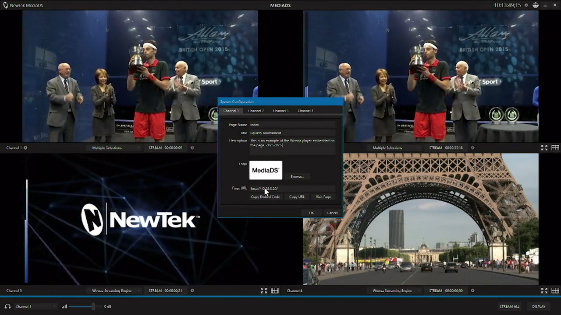
Demonstration: MediaDS
Ryan Jespersen

Slide 22
MediaDS Comparison Chart
Function | Device | Approximate Cost | Notes
Encoding | Purpose built encoders (x4) | $10,000 | $500 to $5,000 per channel
Streaming | Wowza Streaming Engine | $1,995 | Perpetual License
Servers | Servers and Infrastructure | $1,500
Monitoring | Multiviewer | $495 | Such as a BMD Multiview 4
SDI I/O | 3G-SDI capture cards (x4) | $1,000 | $495 to $2,200
NDI I/O | NewTek Connect Pro / Connect Spark | $2,000 | $2,000 to $6,000 for 4 SDI channels
Audio I/O | XLR interface card, ¼” interface card | In NDI I/O
Signal Monitoring | Waveform / Vectorscope | $5,000 | $600 to $10,000 between h/w & s/w
Video Tools | Color Correction Device(s) | N/A | Only available in-camera or post-prod
Audio Tools | Audio Digital Signal Processing | $350 | $40 to $600 for dedicated sound card
Player | 3rd Party Player(s) | N/A | Open source, consider TCO
Webpages | Hosted Webpages | N/A | Open source, consider TCO
 | APPROXIMATE TOTAL | $22,340

Slide 23
Questions & Answers

Slide 24







WWW.WOWZA.COM
www.linkedin.com/company/wowza-media-systems
www.facebook.com/wowza
www.youtube.com/user/wowzamedia
www.twitter.com/wowzamedia
www.plus.google.com/+wowza/posts
“Wowza” and other identified trademarks are either registered or claimed trademarks of Wowza Media Systems, LLC;
visit wowza.com/legal/trademarks for more information. Third-party trademarks are property of their respective owners;
their use does not imply endorsement of Wowza products or services by the trademark owner.

