Slide 1
Wowza Winter 2017 Product Update
Improving Streaming Success
James Jackson
Dir. Solutions and Prod. Mktg.
Jamie Sherry
Sr. Product Manager
Evan Paul
Dir. of Product Mktg.

Slide 2




Wowza Streaming Engine
SRT Midgress and Delivery
Wowza ClearCaster
Customizable Talent-View and Countdown
Enhanced Remote Administration
Wowza Streaming Cloud
Updated REST API Documentation
Notes:
To learn more about how organizations are using Facebook Live, Wowza Media Systems surveyed over 700 video-streaming professionals across a range of industries. Our Facebook Live Streaming Benchmark Report 2017 found some compelling results; get the complete report below.

Slide 3

SRT Stream Target
Long Haul
Scale
Distribution/Delivery
Lower Cost
Reduce Risk
Release 4.7.3
Now Available

Slide 4


























Slide 5

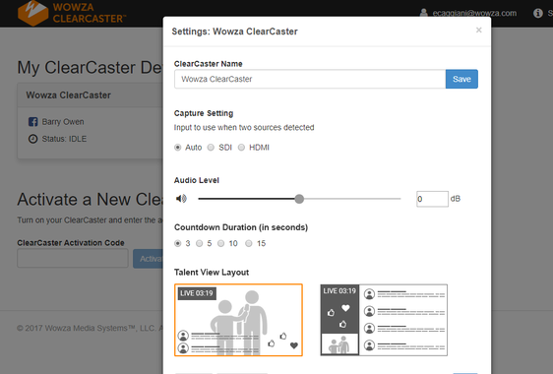
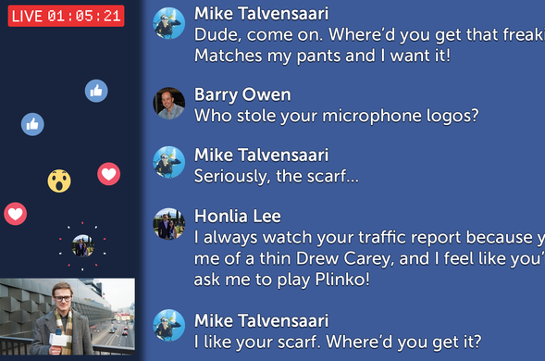
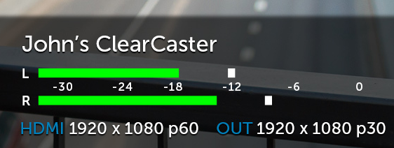
Enhanced Talent View
Selectable Layouts
Hide/show comments
Customizable start countdown
Enhanced Administration
Remote admin pairing
Video Input/output level visibility
Audio levels
Release 1.0.1
Now Available

Slide 6

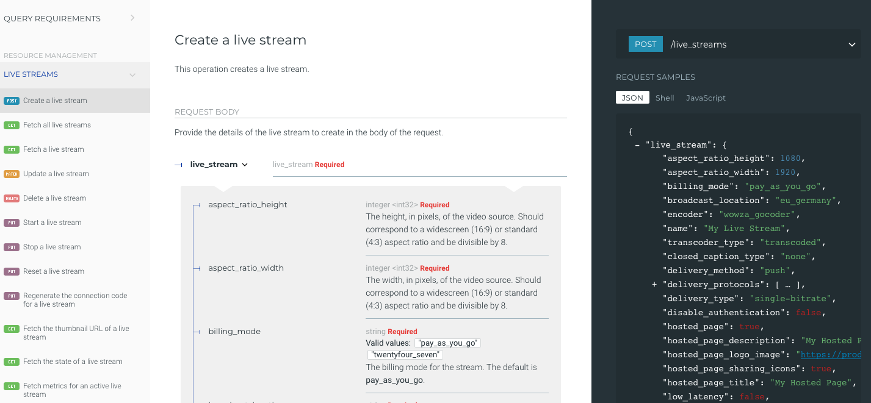
Leveraging ReDoc
OpenAPI spec driven
Promoting modularity and cross compatibility
Search
Multiple Language Examples
Links to supporting docs
Updated API Documentation

Slide 7
Q & A

Slide 8

$200 of Wowza Streaming Engine Perpetual
Through Dec. 2017
Use Code: LastChance17
CES Las Vegas
Jan. 9th-12th 2018
Denver Video Technology Meetup
Feb. 1st 2018
https://www.meetup.com/Denver-Digital-Video/
Streaming Forum
London UK Feb. 27th – Mar. 1st
ProClaim18
Nashville, TN Feb. 27th 2018

Slide 9
Thank You

